Slide 1
How to for Griffins Pages
For Griffins pages update Q1-Q3 2022
For use by the Axway University team

Slide 2

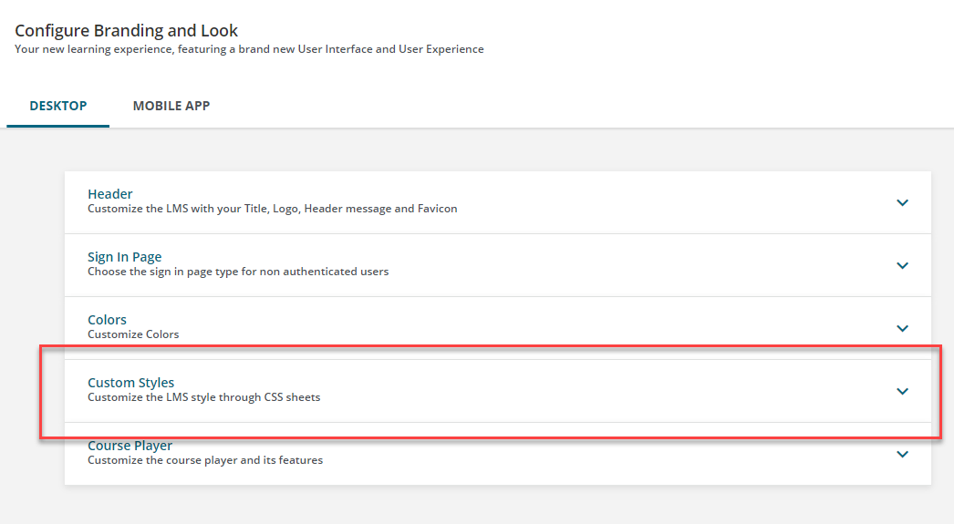
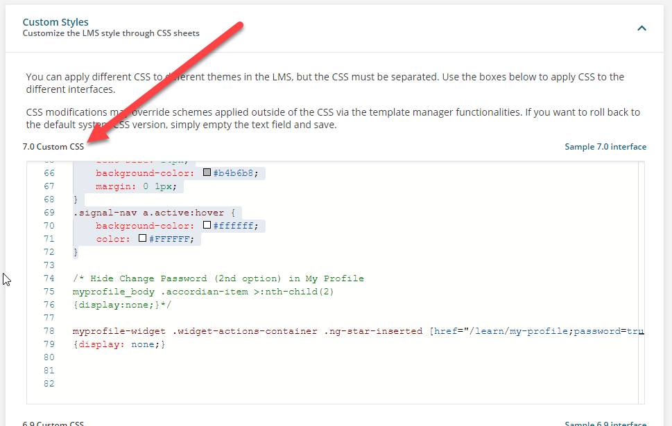
Before you view page build out, a note about CSS Code
Most slides will allow users to select options from a grid. All of those icons highlight when hovered over.
To achieve this effect, CSS code is used. Place CSS code that is linked to the right in the following area:
Click for the CSS code

Slide 3









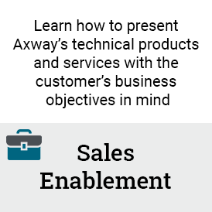


Click on an icon below to view how the page is constructed
Home page
Current Enrollments

Slide 4
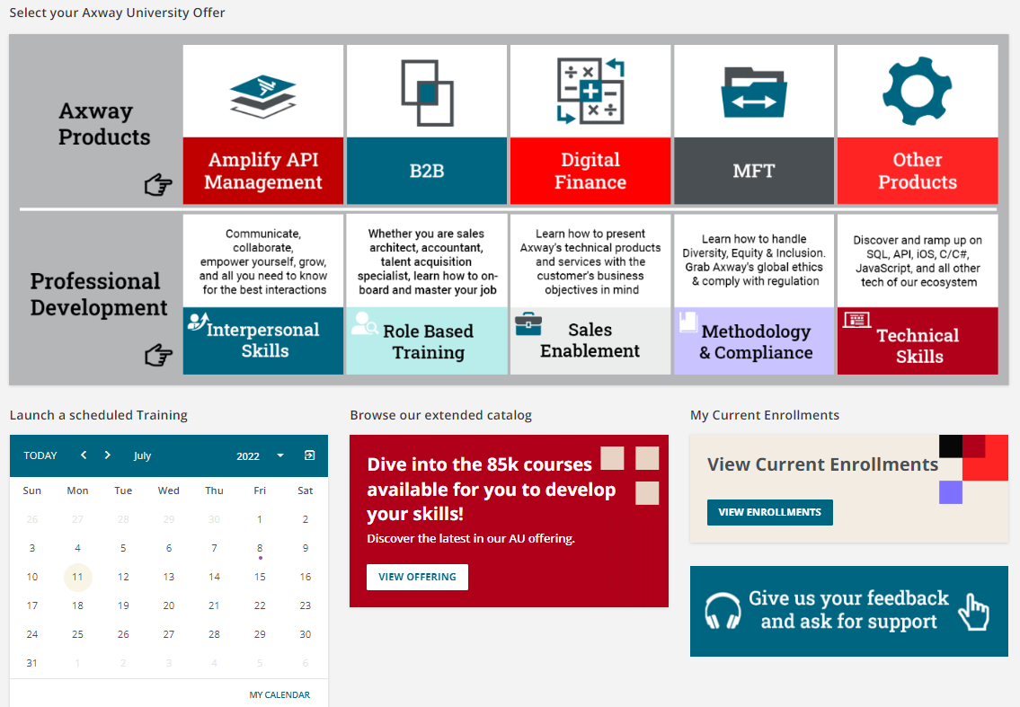
Homepage
All related files located here: Griffins Pages
HTML Widget: Each square icon is an image that is linked. Grey images are not linked as they are labels
Custom content widget using image “tan 2 lines”, linked to Current enrollments page: “/pages/45/my-current-enrollments”
Calendar widget to allow instructors access to courses they are instructing.
Image widget with image “feedback” linked as follows: mailto:axway.university@axway.com?subject=Feedback
Custom content widget using image called 3 lines true. Linked to content marketplace “/marketplace/details/csp/6”

Slide 5
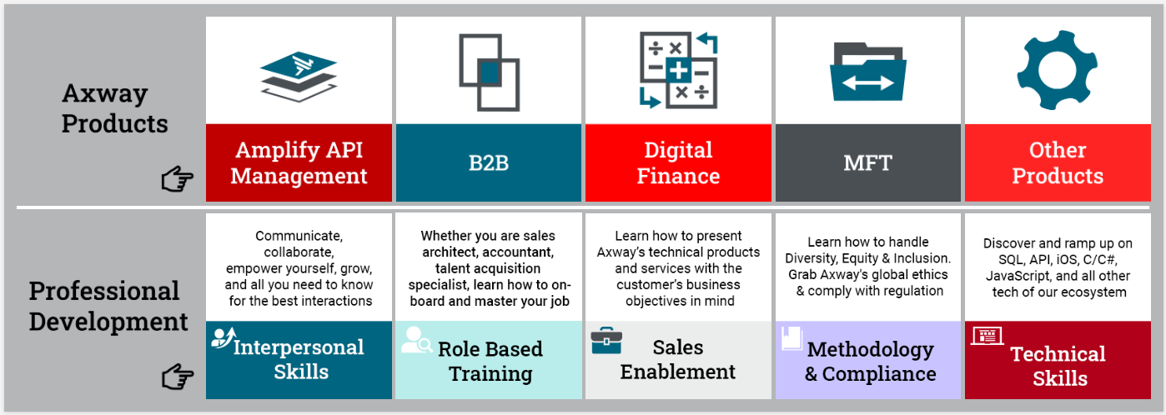
Homepage – HTML Widget Specifics
Image file: “API Block”
Link: /learn/catalog/view/6
Image file: “b2b block”
Link: /pages/69/b2b-for-employees
Image file: “digfin block 2.png”
Link: /pages/48/digital-finance-for-employees?ctl263=field1-_94
Image file: “mft block.png”
Link: /pages/38/mft-for-employees
Image file: “OP block.png”
Link: /learn/catalog/view/4?ctldoc-catalog-0=field1-_6_7_66~field3-_44_45_46
Image file: “product grey.png”
Link: none
Image file: “product grey.png”
Link: none
Image file: “interpersonal clean 6.16.22_v2.png”
Link: TBD
Image file: “RBT clean FINAL.png”
Link: /pages/41/role-based-training-axway
Image file: “sales enablement clean.png”
Link: TBD
Image file: “sandc text.png”
Link: TBD
Image file: “Tech skills clean 6.8.22”
Link: /pages/42/technical-skills?ctl206=category_id-2

Slide 6

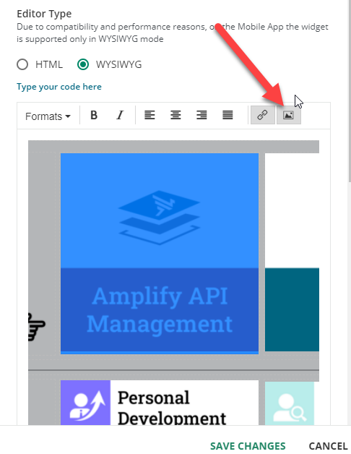
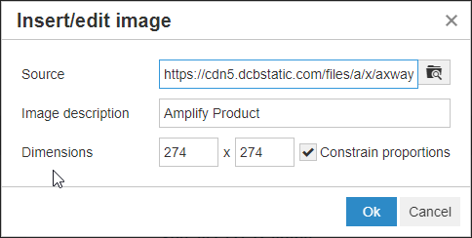
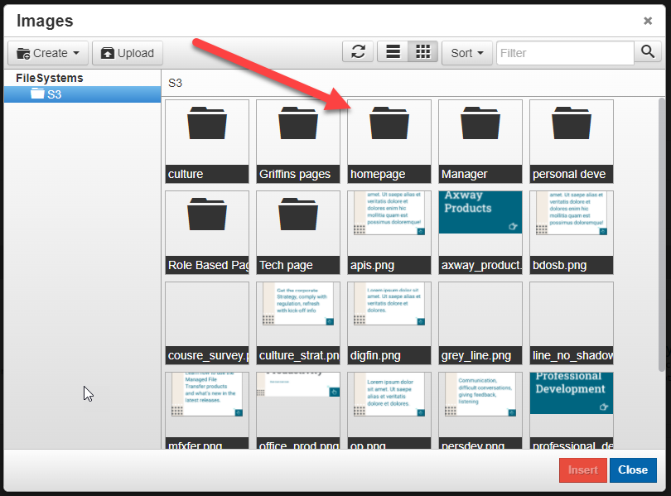
Homepage – HTML Images
Click to access image folder
All images uploaded to Image repository in Docebo – created a special folder for each page.
All images should be resized to 274x274
From the WYSIWYG, click the image icon to upload an image to the repository.

Slide 7
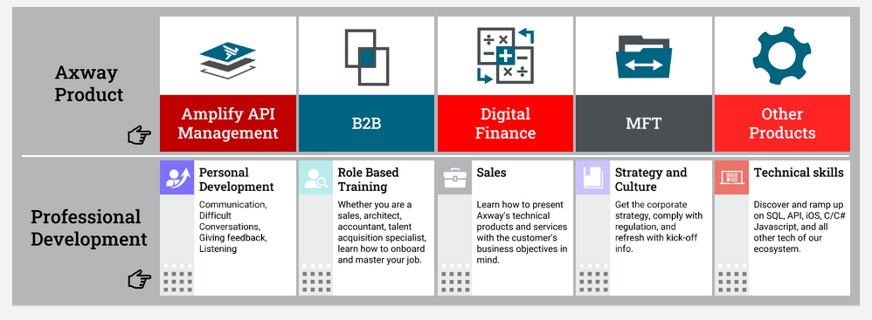
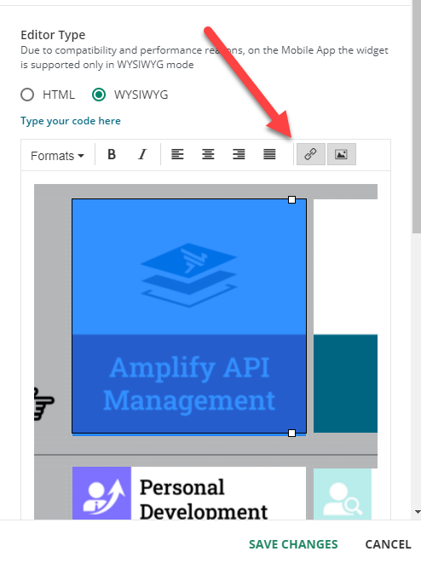
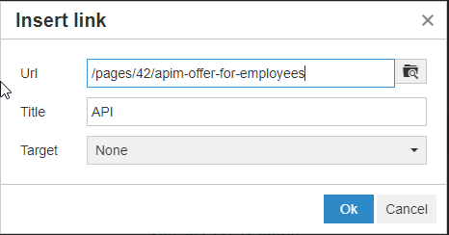
Homepage – HTML Widget Code and links
Click to access link list for each icon.
Links can be added straight into the HTML code, or you can update the link from the WYSIWYG
Click for the full HTML code
Note: Set the target to “None”, so that the URL opens in the same page (prevents a new tab from opening).

Slide 8
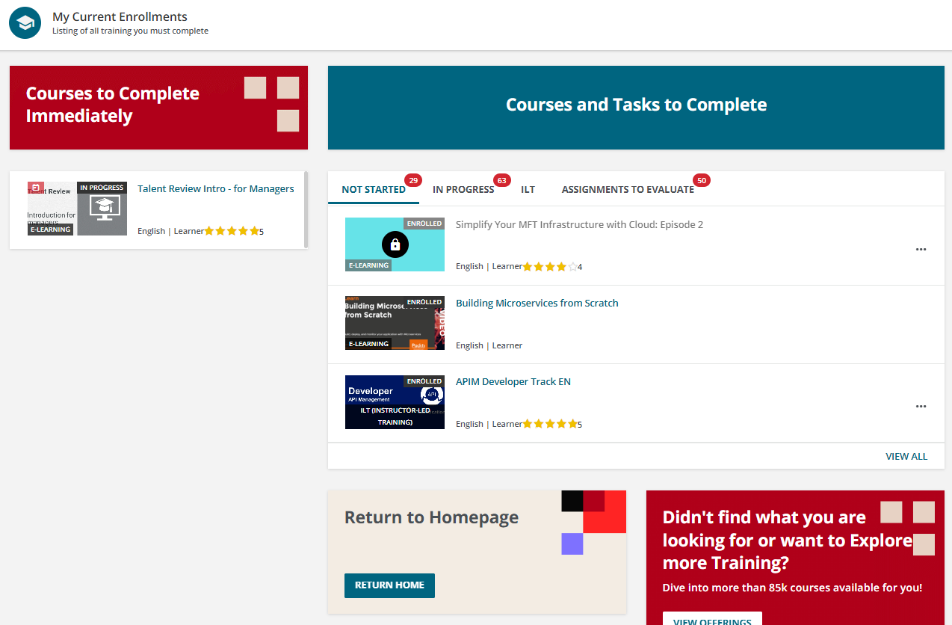
My Current Enrollments Page
Custom Content Widget
Title Only
Image: 1 line blank
Custom Content Widget
Title Only
Background color: #006580
Task widget displaying only deadline courses
Task widget displaying:
Not started
In progress
Upcoming ILT
Assignments to evaluate

Slide 9
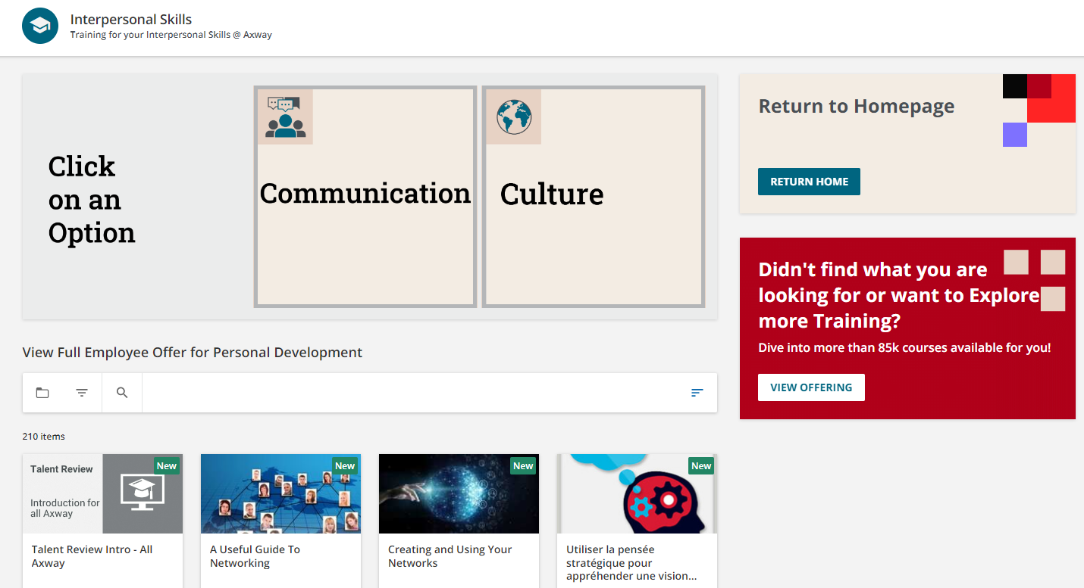
Interpersonal Skills Page
Custom content using image called “tan 2 lines”. Linked to homepage. Widget height set at 184 px.
HTML Widget: Each tan square icon is an image that is linked. Grey images are not linked as they are labels
Custom content using image called “3 lines true”. Linked to content marketplace “/marketplace/details/csp/6”
Catalog of Employee offer (filtered to show courses with Interpersonal Skills offer)

Slide 10
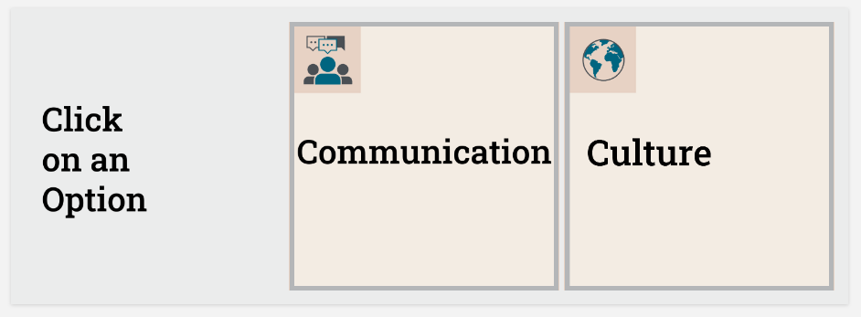
Interpersonal Skill page– HTML Widget Icons
Image file: “click option.png”
Image file: “comms.png”
Link: https://university.axway.com/pages/46/axway-culture
Image file: “mgt.png”
Link: https://university.axway.com/pages/46/axway-culture
Click to access image folder
All images are set to 300x300px.

Slide 11
Interpersonal Skills Page – HTML Widget code and links
Click to access link list for each icon.
Links can be added straight into the HTML code, or you can update the link from the WYSIWYG
Click for the full HTML code for the Widget
Note: Set the target to “None”, so that the URL opens in the same page (prevents a new tab from opening).

Slide 12
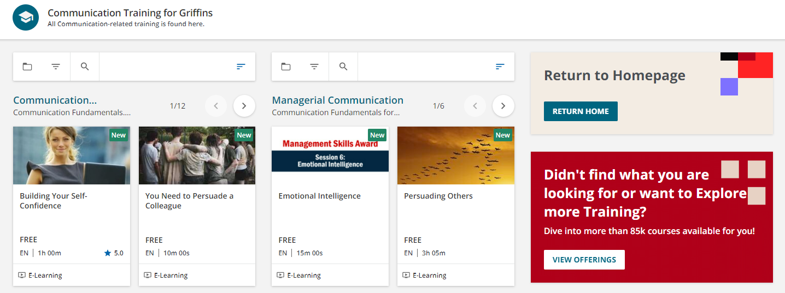
Interpersonal Skill subpage– Communication
Catalog Widget displaying managerial Communication catalog.
Catalog Widget displaying Communication catalog.
Page linked to Communication icon from Interpersonal Skills page

Slide 13
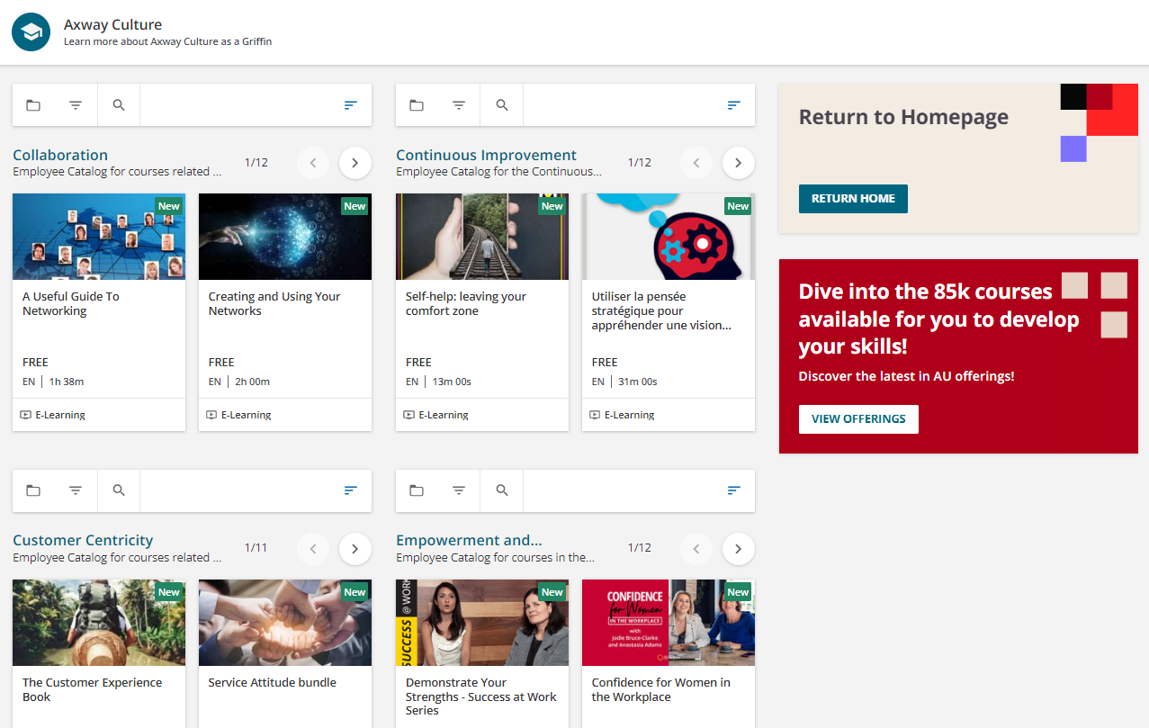
Interpersonal Skill subpage– Culture
Catalog Widget displaying Collaboration catalog.
Catalog Widget displaying Continuous Improvement catalog.
Catalog Widget displaying Customer Centricity catalog.
Catalog Widget displaying Empowerment and Accountability catalog.
Page linked to Communication icon from Interpersonal Skills page

Slide 14
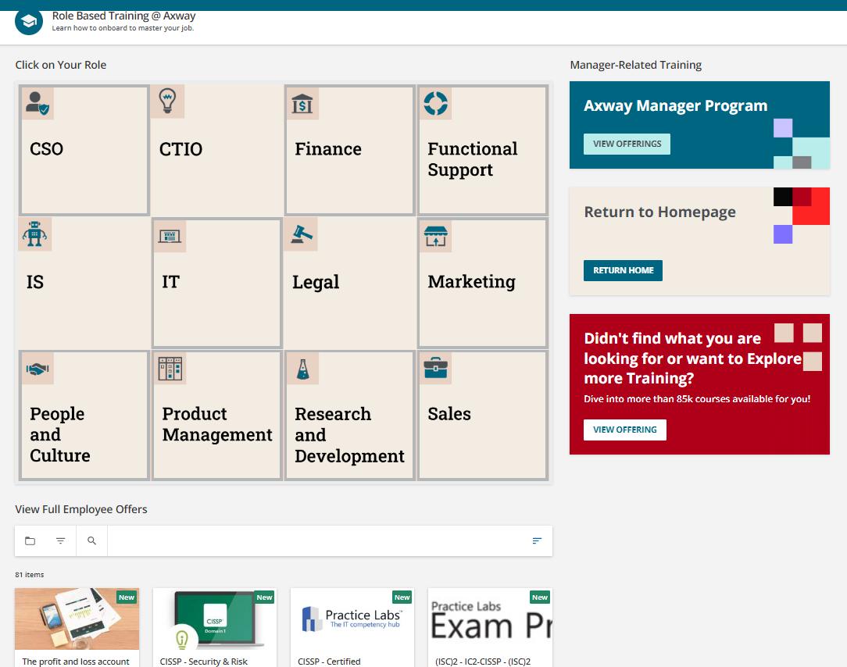
Role Based Training Page
HTML Widget: Each tan square icon is an image that is linked.
Custom content using image called “tan 2 lines”. Linked to homepage. Widget height set at 184 px.
Custom content using image called “tan 2 lines”. Linked to homepage. Widget height set at 184 px.
Custom content using image called “3 lines true”. Linked to content marketplace “/marketplace/details/csp/6”
Catalog of Full Employee offer (filtered view for Role Based Training courses)

Slide 15
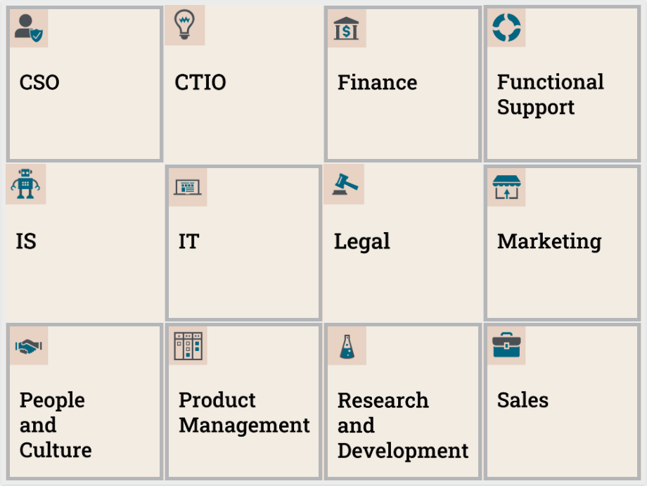
Role Based Training – HTML Widget
Image file: “finance.png”
Image file: “CTIO.png”
Image file: “funsupport.png”
Image file: “CSO.png
Click to access image folder
Image file: “marketing.png”
Image file: “IT2.png”
Image file: “IS.png”
Image file: “legal.png”
Image file: “pandc.png”
Image file: “RANDD.png”
Image file: “ventas.png”
Image file: “product mng.png”
All images are set to 270x270px.

Slide 16
Role Based Training Page – HTML Widget code and links
Links can be added straight into the HTML code, or you can update the link from the WYSIWYG
Click for the full HTML code for the Widget
Note: Set the target to “None”, so that the URL opens in the same page (prevents a new tab from opening).

Slide 17
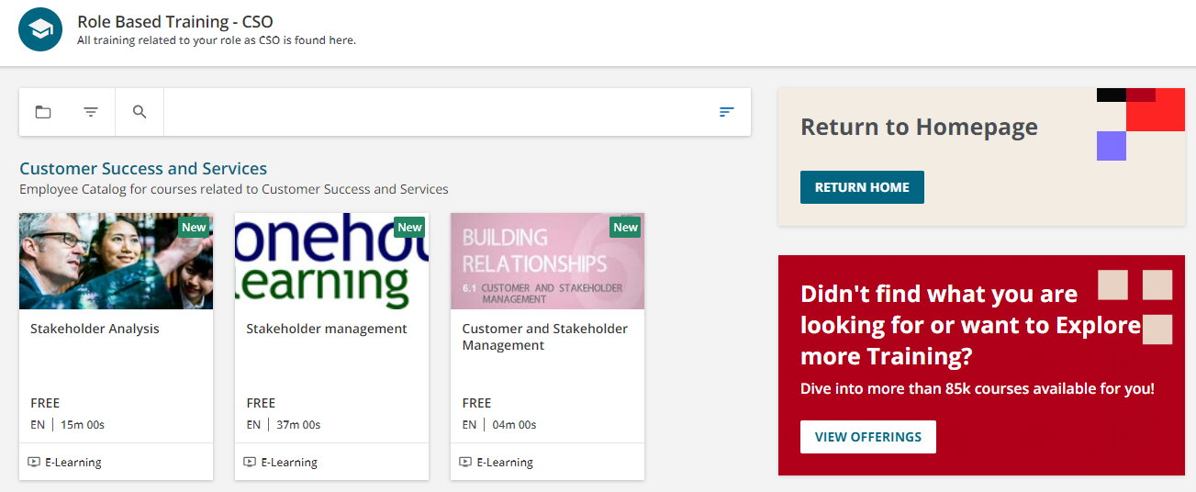
Role Based Training subpage– CSO
Catalog Widget displaying Customer Success and Services catalog.
Page linked to CSO icon from Role Based Training page

Slide 18
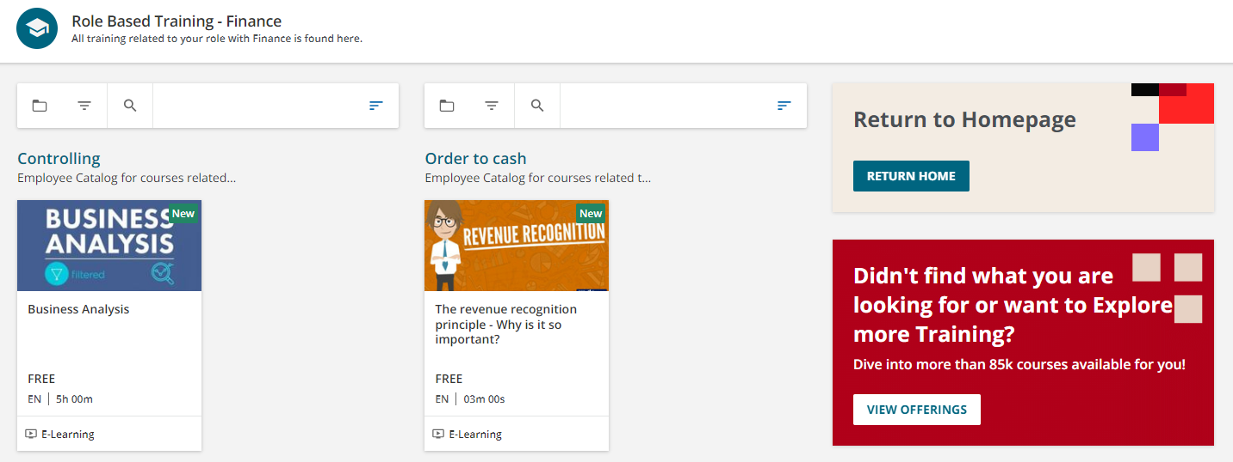
Role Based Training subpage– Finance
Catalog Widget displaying Order to Case catalog.
Catalog Widget displaying Controlling catalog.
Page linked to Finance icon from Role Based Training page

Slide 19
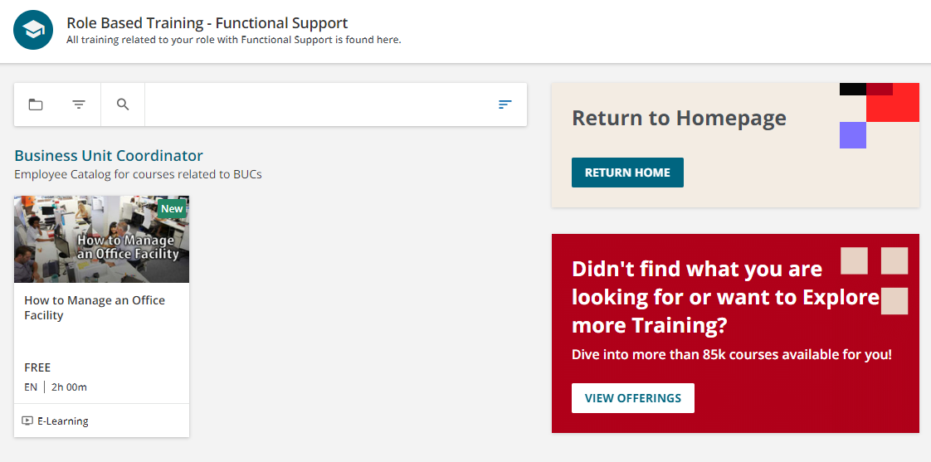
Role Based Training subpage– Functional Support
Catalog Widget displaying Business Unit Coordinator catalog.
Page linked to Functional Support icon from Role Based Training page

Slide 20
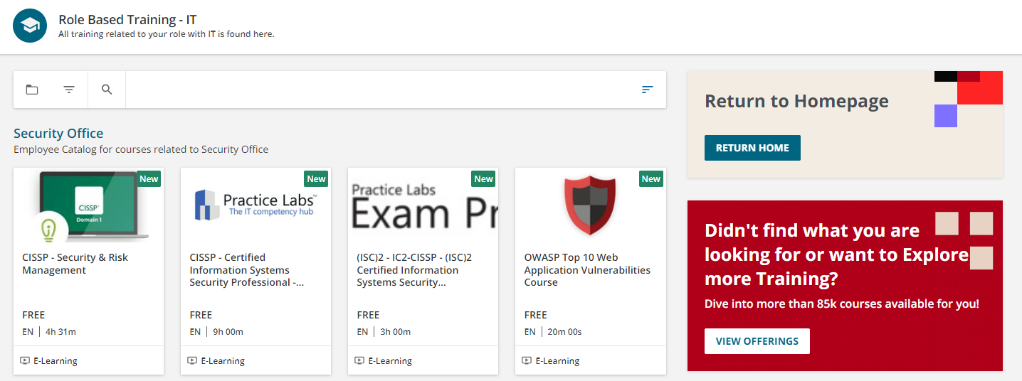
Role Based Training subpage– IT
Catalog Widget displaying Security Office catalog.
Page linked to IT icon from Role Based Training page

Slide 21
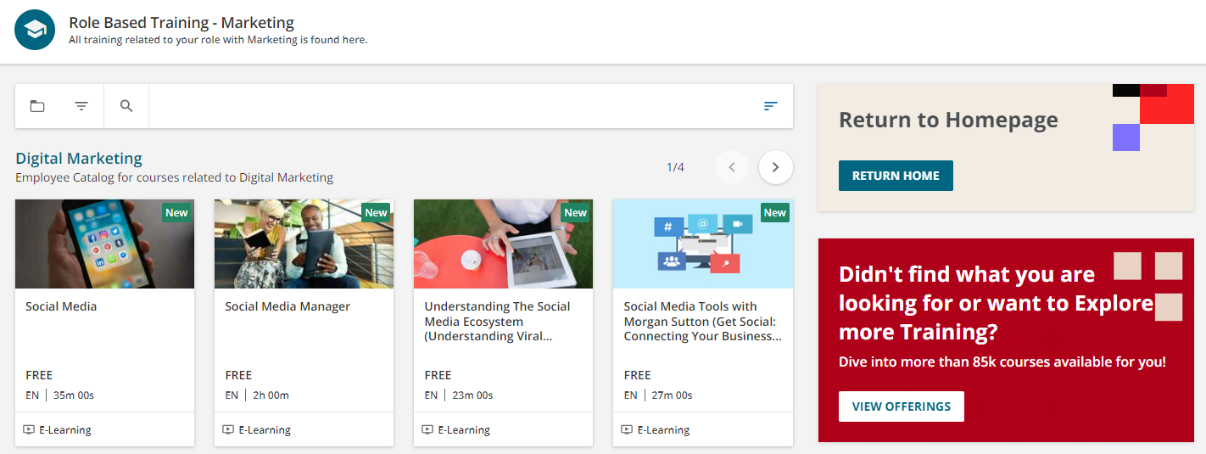
Role Based Training subpage– Marketing
Catalog Widget displaying Digital Marketing catalog.
Page linked to Marketing icon from Role Based Training page

Slide 22
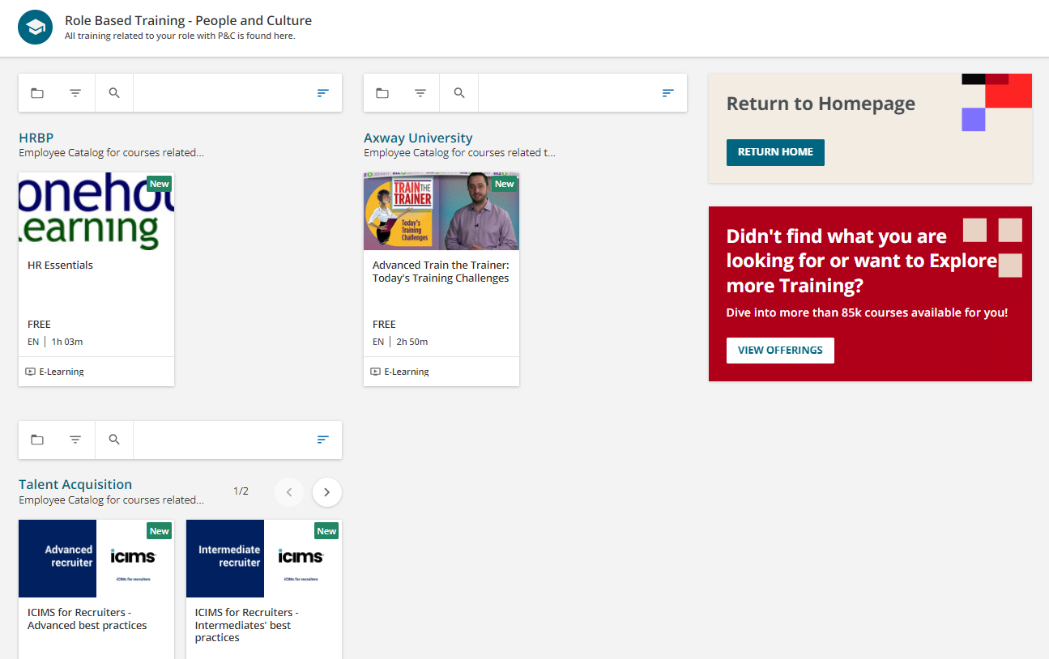
Role Based Training subpage– P&C
Catalog Widget displaying Axway University catalog.
Catalog Widget displaying HRBP catalog.
Catalog Widget displaying Talent Axquisition catalog.
Page linked to P&C icon from Role Based Training page

Slide 23
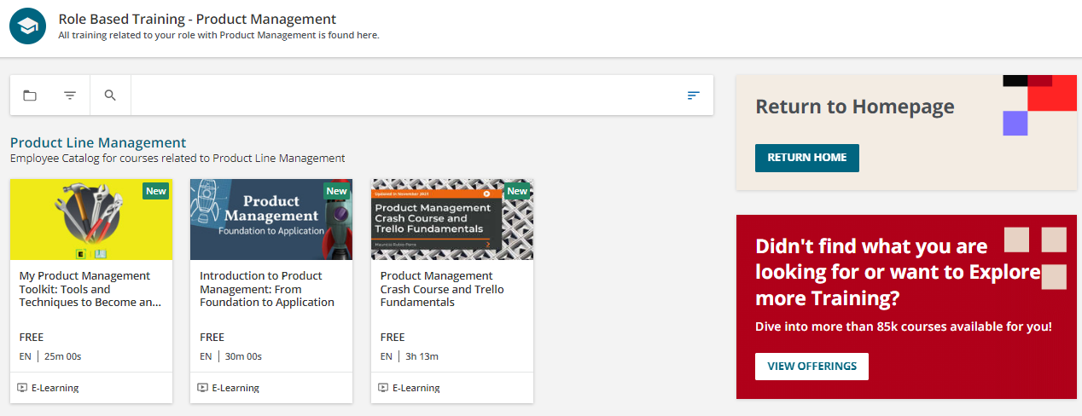
Role Based Training subpage– Product Management
Catalog Widget displaying Product Line Management catalog.
Page linked to Product Management icon from Role Based Training page

Slide 24
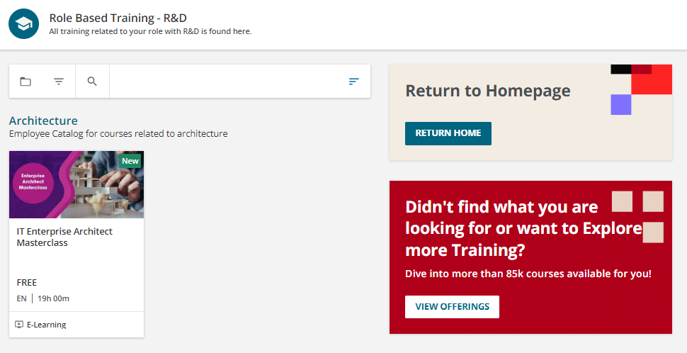
Role Based Training subpage– R&D
Catalog Widget displaying Architecture catalog.
Page linked to Research and Development icon from Role Based Training page

Slide 25
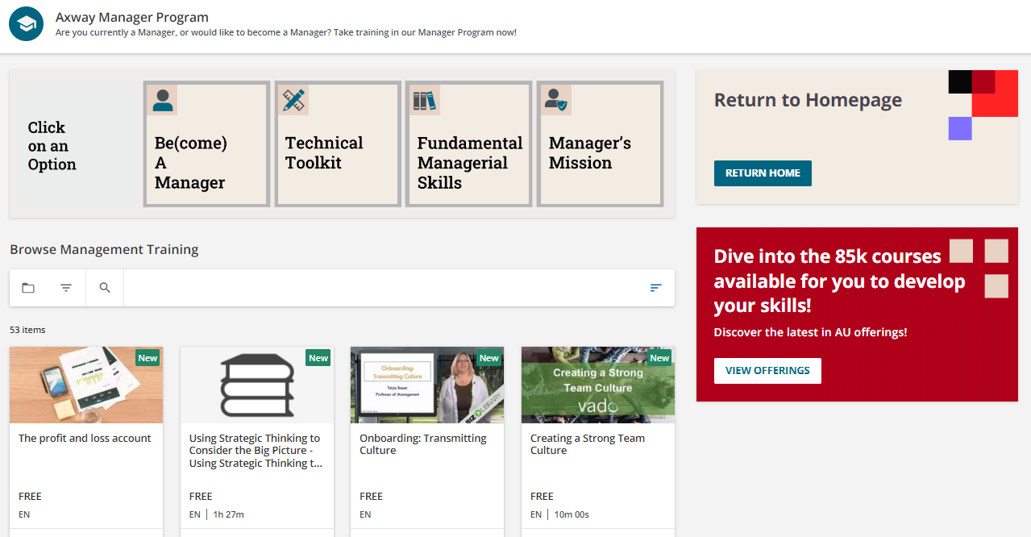
Role Based Training subpage– Axway Manager Program
HTML Widget: Each tan square icon is an image that is linked.
Custom content using image called “tan 2 lines”. Linked to homepage. Widget height set at 184 px.
Custom content using image called “3 lines true”. Linked to content marketplace “/marketplace/details/csp/6”
Catalog of Full Employee offer (filtered view for Axway Management program courses)

Slide 26
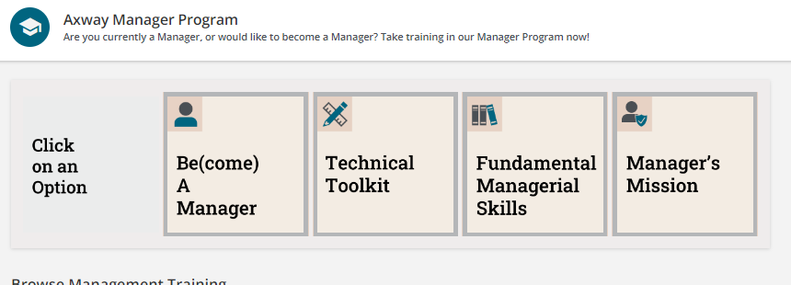
Axway Manager Program– HTML Widget
Image file: “mgr tech skills.png” linked to https://university.axway.com/learn/catalog/view/65
Image file: “become mgr.png” linked to https://university.axway.com/learn/catalog/view/52
Click to access image folder
Image file: “clickoption.png”
Image file: “fund skills mgr.png” linked to https://university.axway.com/learn/catalog/view/63
Image file: “mgr mission.png” linked to https://university.axway.com/learn/catalog/view/64
All images are set to 270x270px.

Slide 27
Axway Manager Program Page – HTML Widget code and links
Click to access link list for each icon.
Links can be added straight into the HTML code, or you can update the link from the WYSIWYG
Click for the full HTML code for the Widget
Note: Set the target to “None”, so that the URL opens in the same page (prevents a new tab from opening).

Slide 28
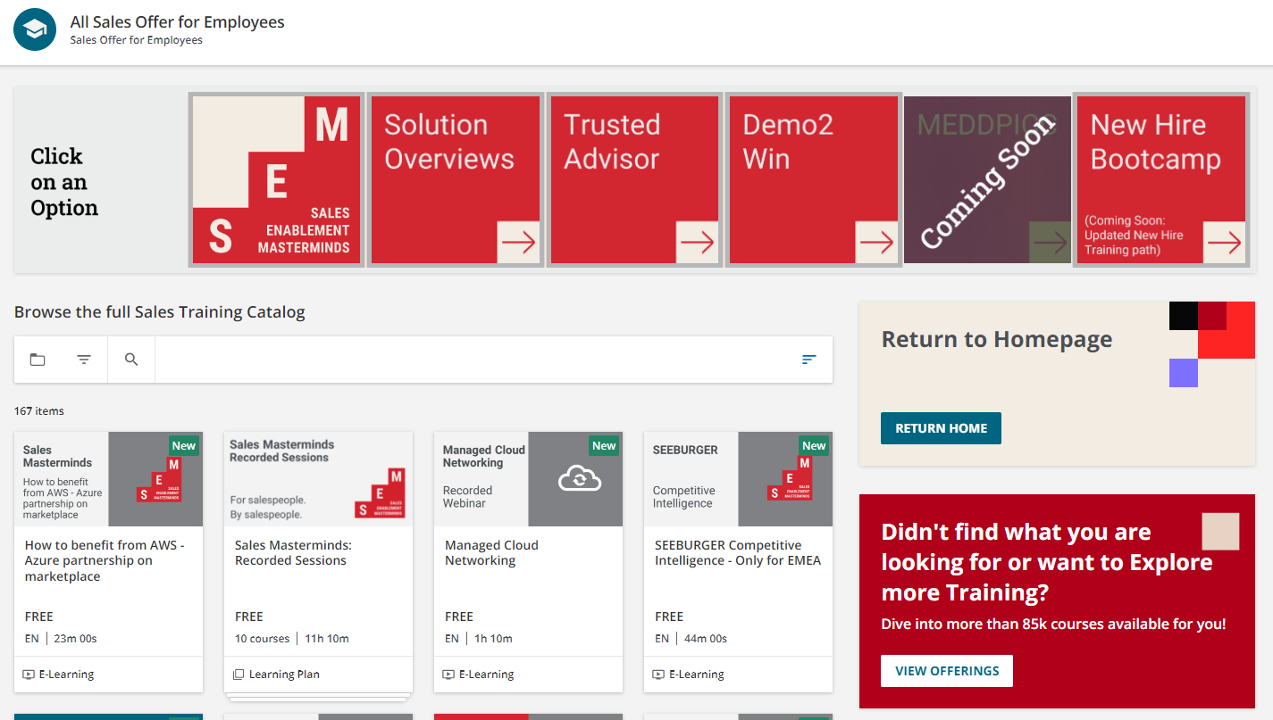
Sales Enablement Page
HTML Widget: Each square icon is an image that is linked. Grey images are not linked as they are labels
Custom content using image called “tan 2 lines”. Linked to homepage. Widget height set at 184 px.
Catalog widget displaying Sales catalog.
Custom content using image called “3 lines true”. Linked to content marketplace “/marketplace/details/csp/6”

Slide 29
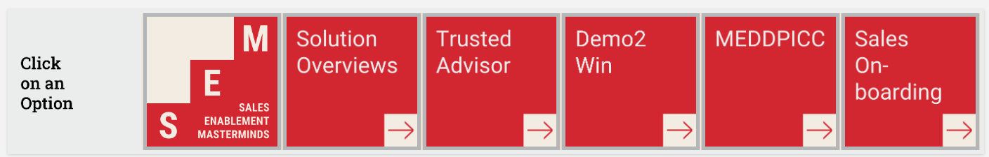
Sales Enablement – HTML Widget
Image file: “SOLN Overviews.png” linked to https://university.axway.com/pages/53/solution-overview-for-employee-sales-training?ctl278=se-%22Solution%20Overview%22&ctl316=se-Clinic
Image file: “SEM.png” linked to https://university.axway.com/pages/77/sales-enablement-masterminds
Image file: “Demo2Win.png” linked to https://university.axway.com/learn/catalog/view/5?ctldoc-catalog-0=se-Demo2Win
Click to access image folder
Image file: “clickoption.png”
Image file: “TA.png” linked to https://university.axway.com/learn/catalog/view/5?ctldoc-catalog-0=se-%22Trusted%20Advisor%22
Image file: “meddpicc.png” , linked to: https://university.axway.com/learn/course/internal/view/elearning/11430/meddpicc---qualify-your-deal
Image file: “new hire.png” linked to https://university.axway.com/pages/72/sales-onboarding
All images are set to 270x270px.

Slide 30
Sales Enablement – HTML Widget code and links
Click to access link list for each icon.
Links can be added straight into the HTML code, or you can update the link from the WYSIWYG
Click for the full HTML code for the Widget
Note: Set the target to “None”, so that the URL opens in the same page (prevents a new tab from opening).

Slide 31
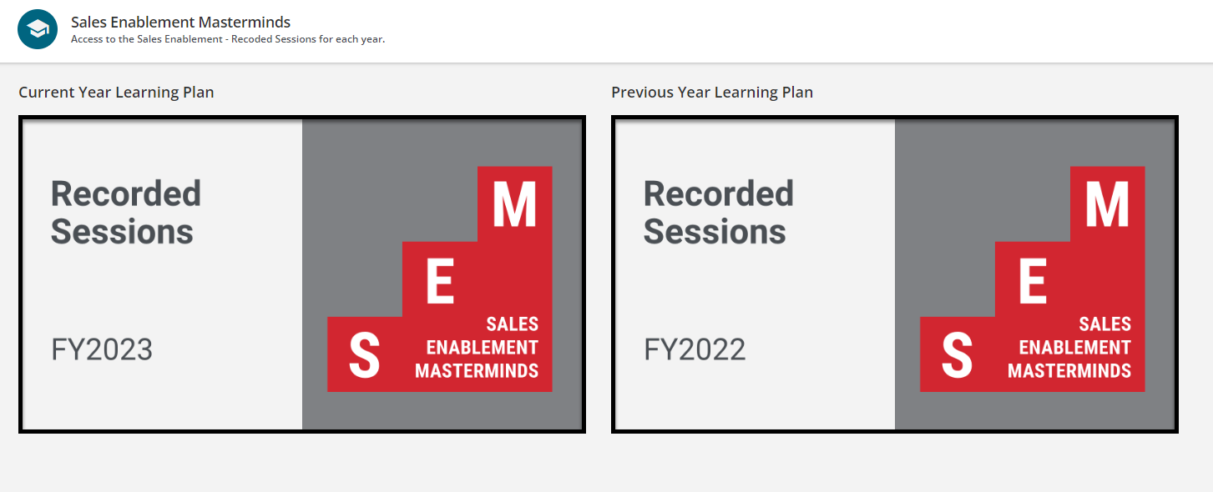
Sales Masterminds Landing Page
Linked to https://university.axway.com/learn/lp/96/FY2022%2520Sales%2520Masterminds%253A%2520Recorded%2520Sessions
Linked to https://university.axway.com/learn/learning_plan/view/133/fy2023-sales-masterminds-recorded-sessions
Note: The images were created using the AU V2 Generic Thumbnail.pptx

Slide 32
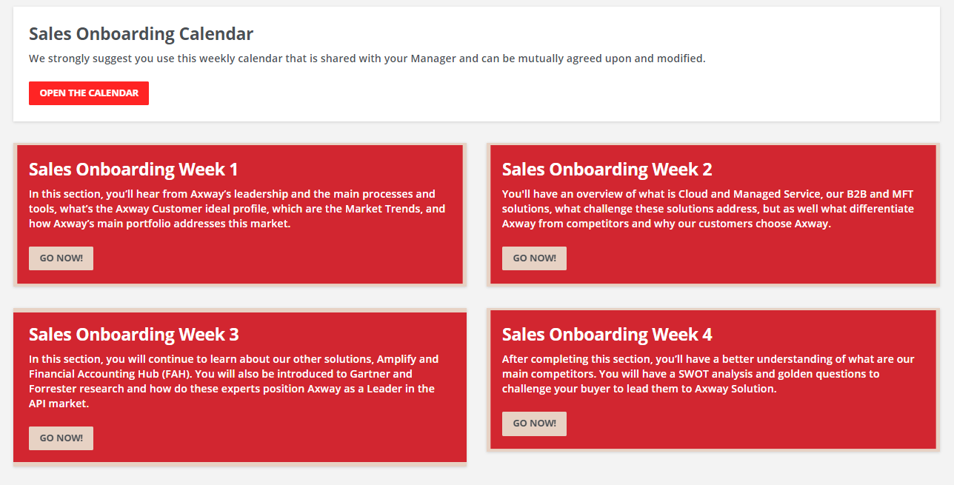
Sales Enablement Sales Onboarding page
Custom content widget pointed to: Rosetta’s Onboarding calendar
Custom content widget pointed to: Sales Onboard week 2 LP
Custom content widget pointed to: Sales Onboard week 1 LP
Custom content widget pointed to: Sales Onboard week 4 LP
Custom content widget pointed to: Sales Onboard week 3 LP

Slide 33
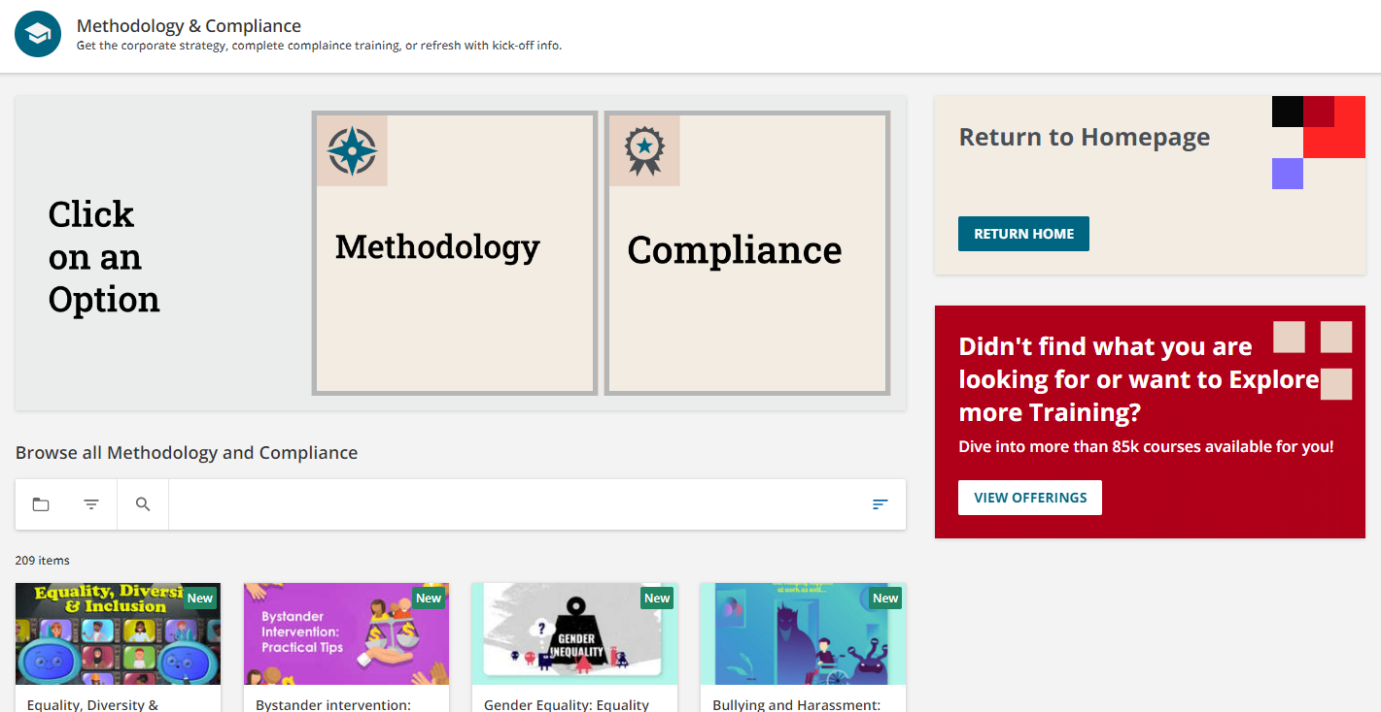
Methodology and Compliance Page
HTML Widget: Each tan square icon is an image that is linked. Grey images are not linked as they are labels
Custom content using image called “tan 2 lines”. Linked to homepage. Widget height set at 184 px.
Custom content using image called “3 lines true”. Linked to content marketplace “/marketplace/details/csp/6”
Full Employee Offer catalog filtered to Methodology and Compliance

Slide 34
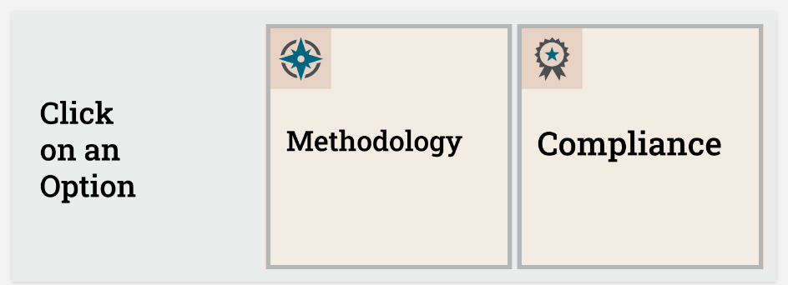
Methodology and Compliance page– HTML Widget
Click to access image folder
Image file: “method.png”
Image file: “compliance.png”
Image file: “click role grey.png”
Link: none
All images are set to 270x270px.

Slide 35
Methodology and Compliance page– HTML Widget code and links
Click to access link list for each icon.
Links can be added straight into the HTML code, or you can update the link from the WYSIWYG
Click for the full HTML code for the Widget
Note: Set the target to “None”, so that the URL opens in the same page (prevents a new tab from opening).

Slide 36
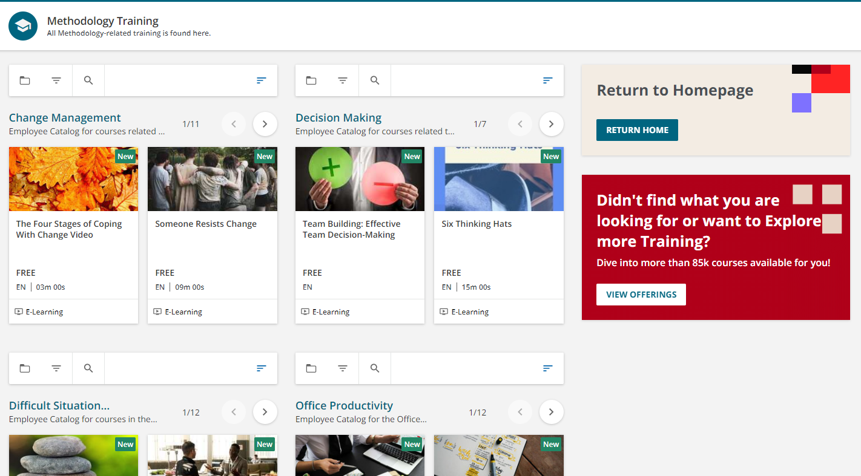
Methodology and Compliance subpage - Methodology
Catalog Widget with Decision making catalog.
Catalog Widget with Change management catalog.
Catalog Widget with Office productivity catalog.
Catalog Widget with Difficult Situation catalog.

Slide 37
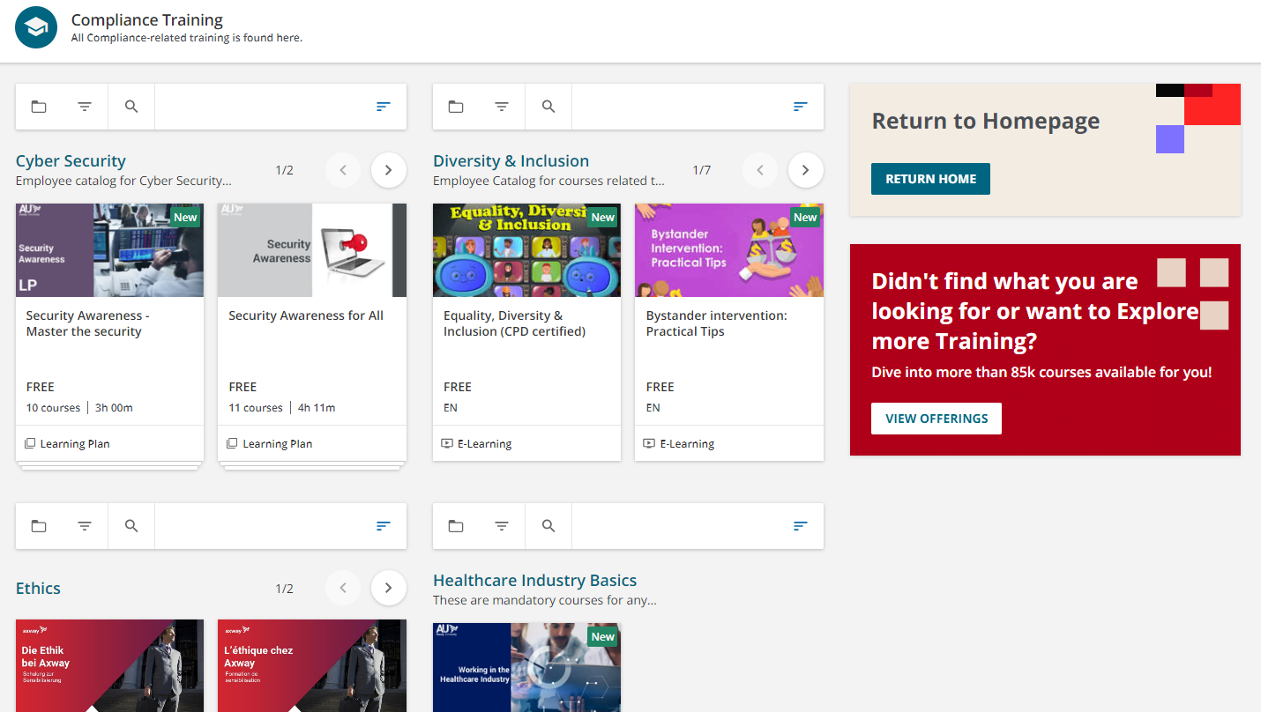
Methodology and Compliance subpage - Compliance
Catalog Widget with Diversity and Inclusion catalog.
Catalog Widget with Cyber Security catalog.
Catalog Widget with Office productivity catalog.
Catalog Widget with Difficult Situation catalog.

Slide 38
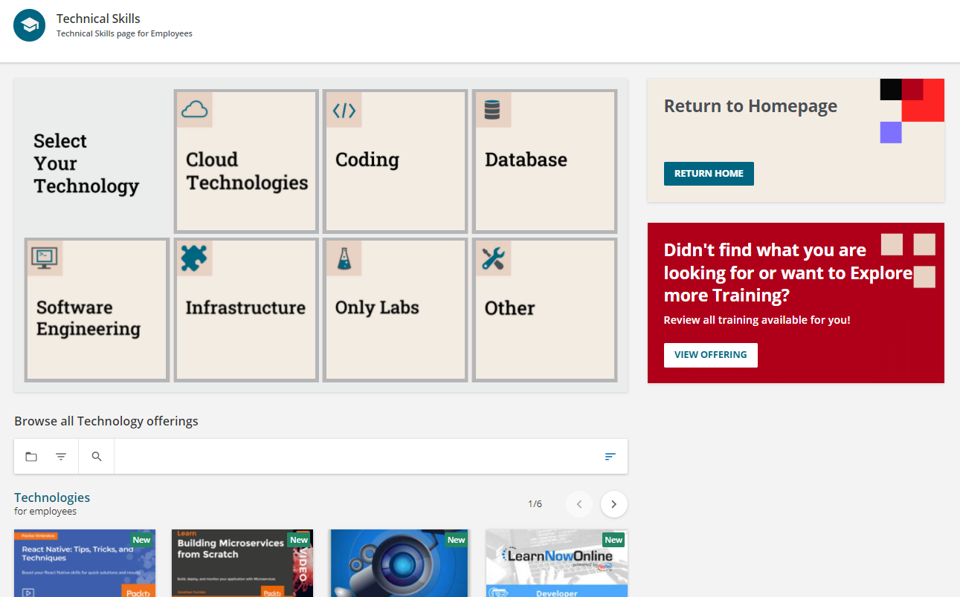
Technical Skills Page
HTML Widget: Each tan square icon is an image that is linked. Grey images are not linked as they are labels
Custom content using image called “tan 2 lines”. Linked to homepage. Widget height set at 184 px.
Custom content using image called “3 lines true”. Linked to content marketplace “/marketplace/details/csp/6”
Catalog of Technologies.

Slide 39
Tech Skills Page– HTML Widget
Image file: “select grey.png”
Link: none
Image file: cloud tech.png”
Image file: “code tech.png”
Image file: “db tech.png”
Click to access image folder
Image file: “software eng.png”
Image file: “infrastructure.png”
Image file: “only labs.png”
Image file: “other tech.png”
All images are set to 270x270px.

Slide 40
Tech Skills Page– HTML Widget code and links
Click to access link list for each icon.
Links can be added straight into the HTML code, or you can update the link from the WYSIWYG
Click for the full HTML code for the Widget
Note: Set the target to “None”, so that the URL opens in the same page (prevents a new tab from opening).

